Slide 1
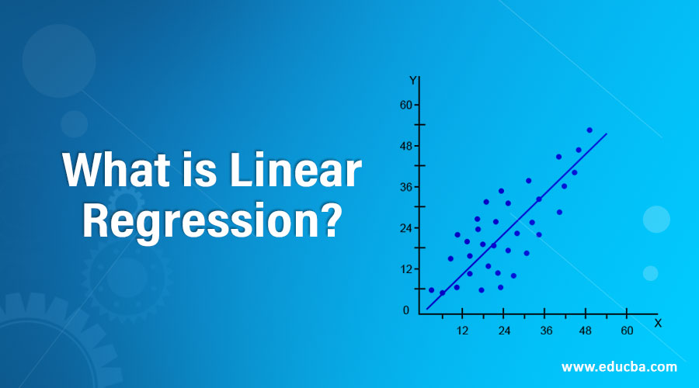

Slide 2
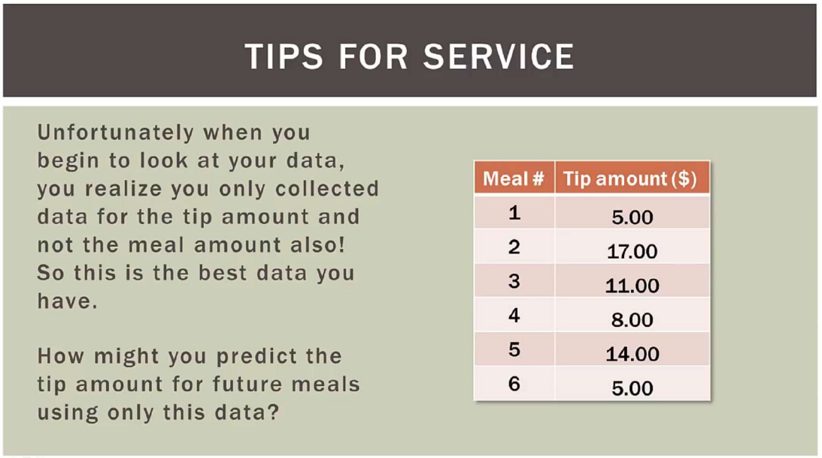

Slide 3
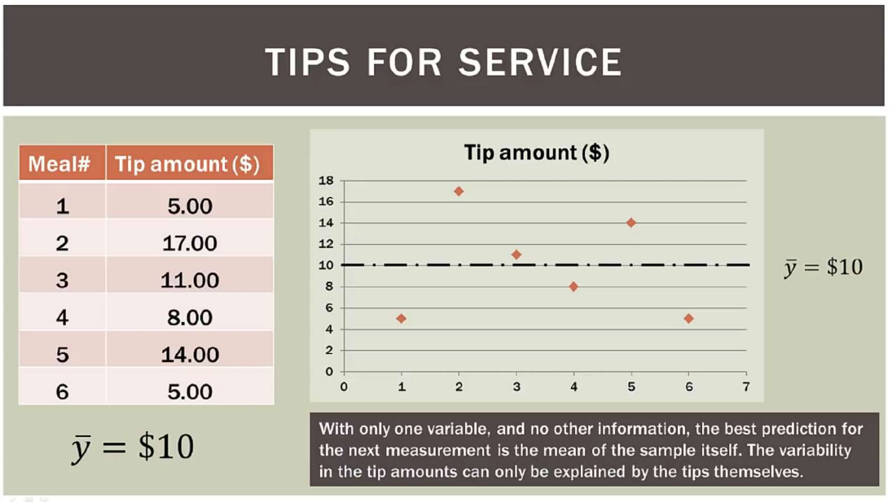

Slide 4
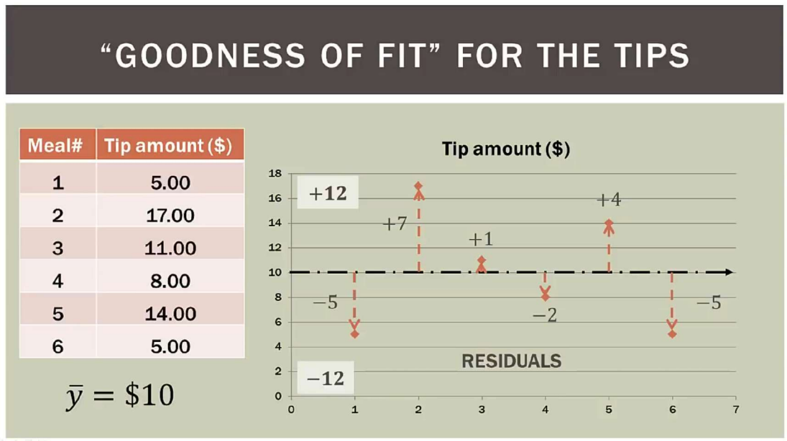

Slide 5
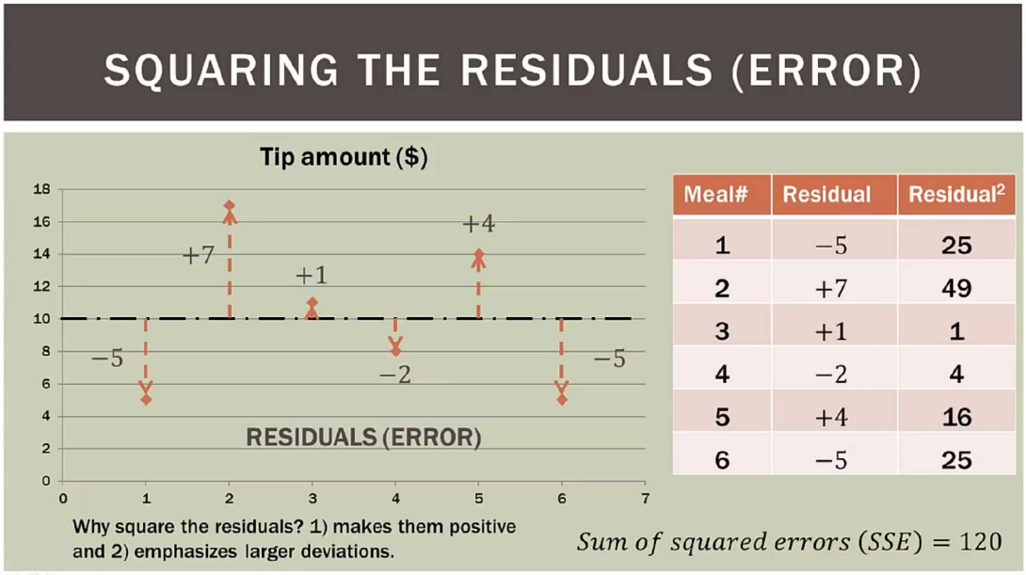

Slide 6
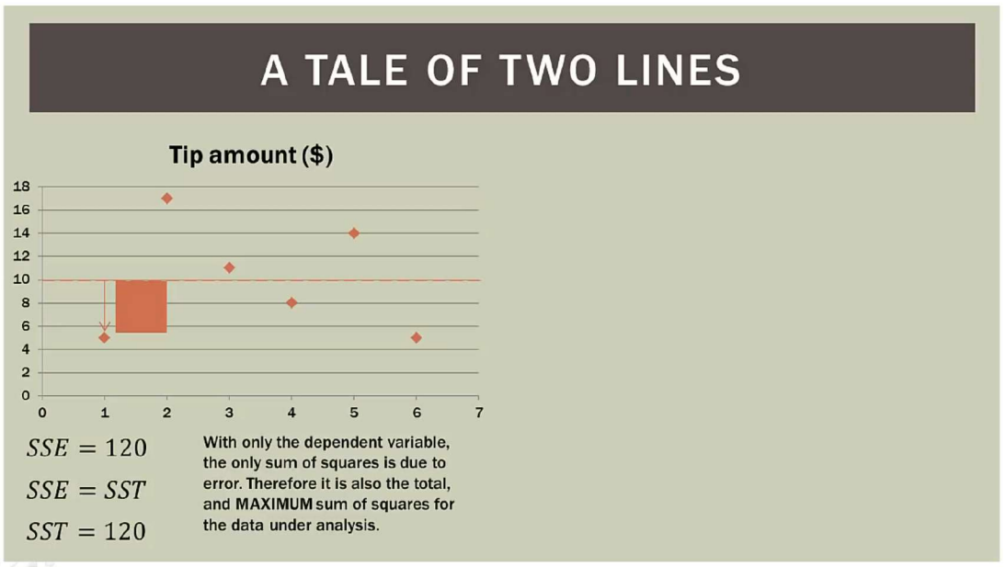

Slide 7
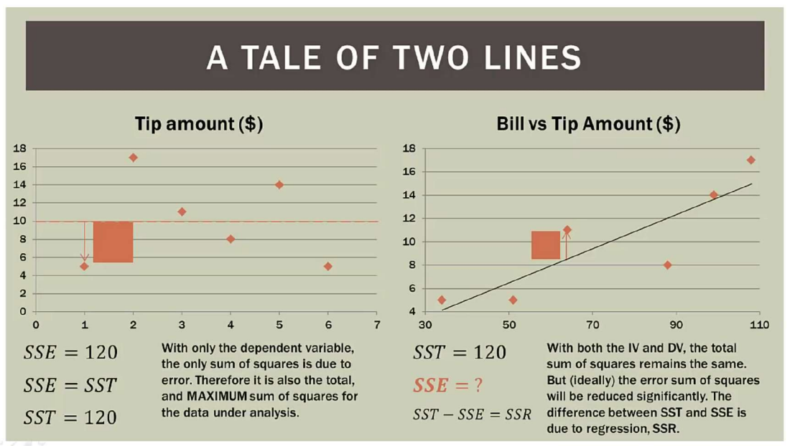

Slide 8
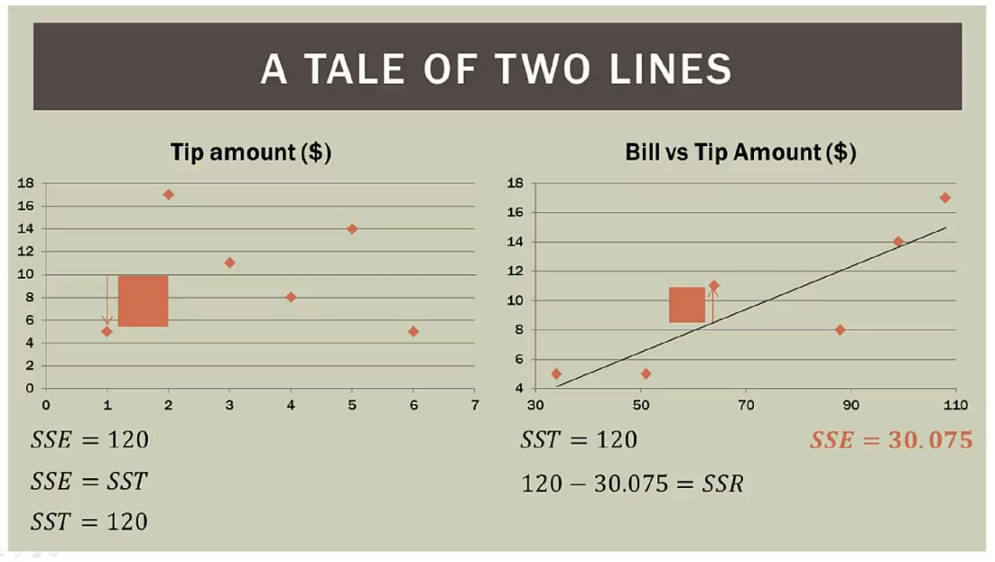

Slide 9
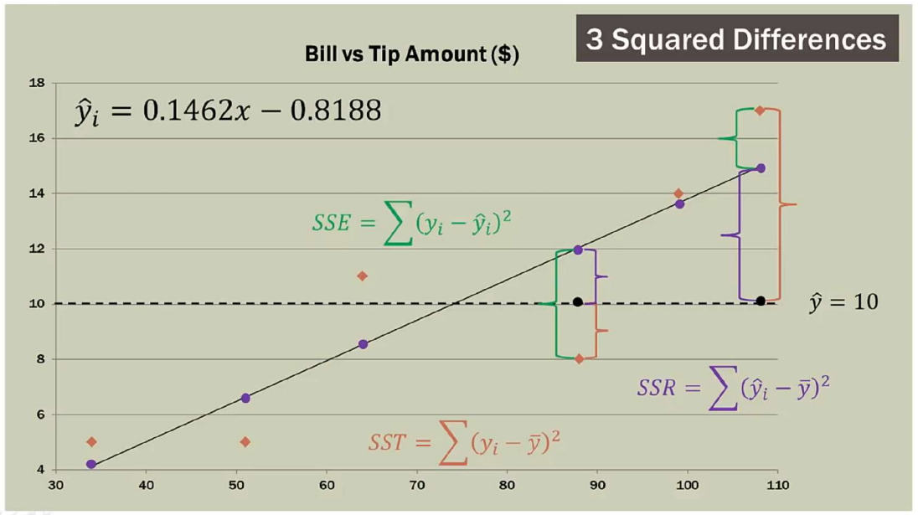

Slide 10

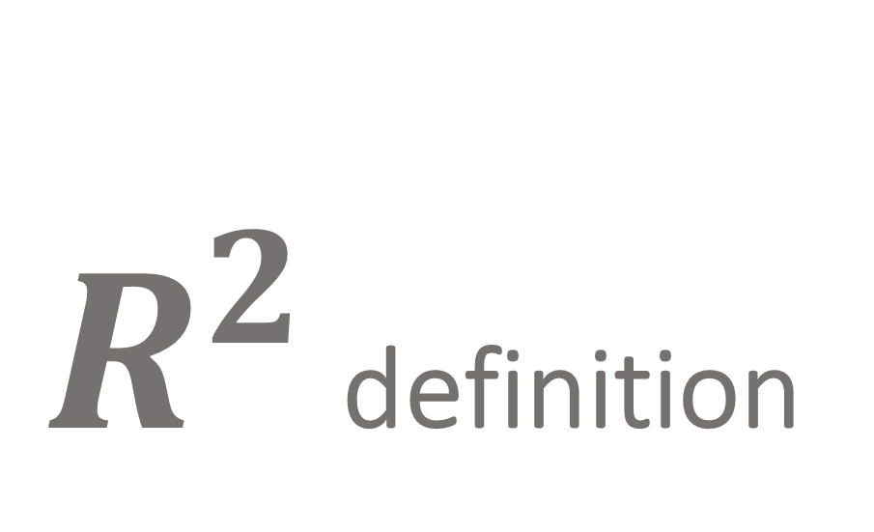
$R^{2}$ definition

Slide 11
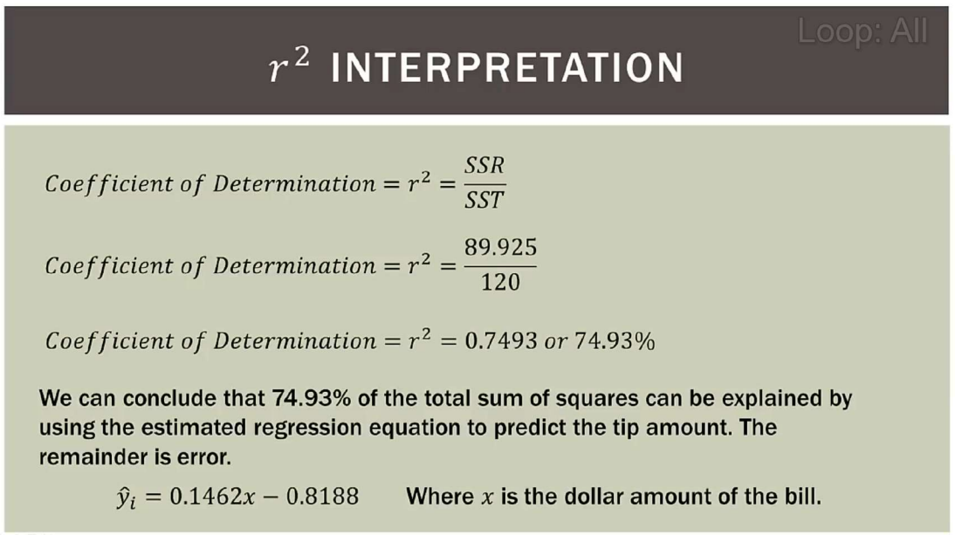

Slide 12
y = β0 + β1 ​​x + ϵ
Simple Linear Regression Model

Slide 13
.
yi = β0 + β1 x i + ε i
y1 = β0 + β1 x1 + ε1,
y2 = β0 + β1 x2 + ε2,
. . . yn = β0 + β1 xn + εn

Slide 14

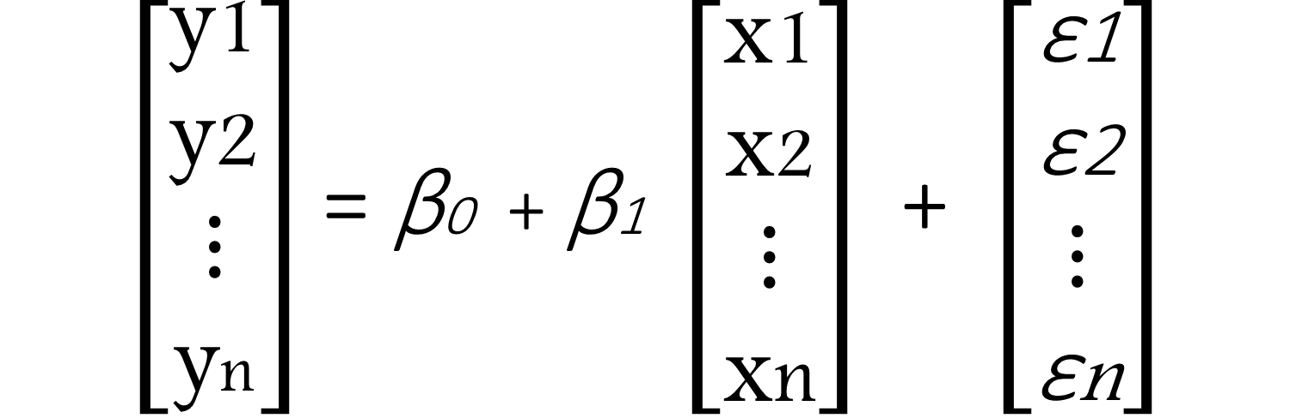


$\left[\begin{aligned}\text{y}\text{1} \\ \text{y}\text{2} \\ ⋮ \\ \text{y}\text{n}\end{aligned}\right]$ = β0 + β1 $\left[\begin{aligned}\text{x}\text{1} \\ \text{x}\text{2} \\ ⋮ \\ \text{x}\text{n}\end{aligned}\right]$ + $\left[\begin{aligned}\text{ε}\text{1} \\ \text{ε}\text{2} \\ ⋮ \\ \text{ε}\text{n}\end{aligned}\right]$
= β0 + β1 $\overset{⃑}{x}$+
$$\overset{⃑}{y}$$
$$\overset{⃑}{\text{ε}}$$

Slide 15
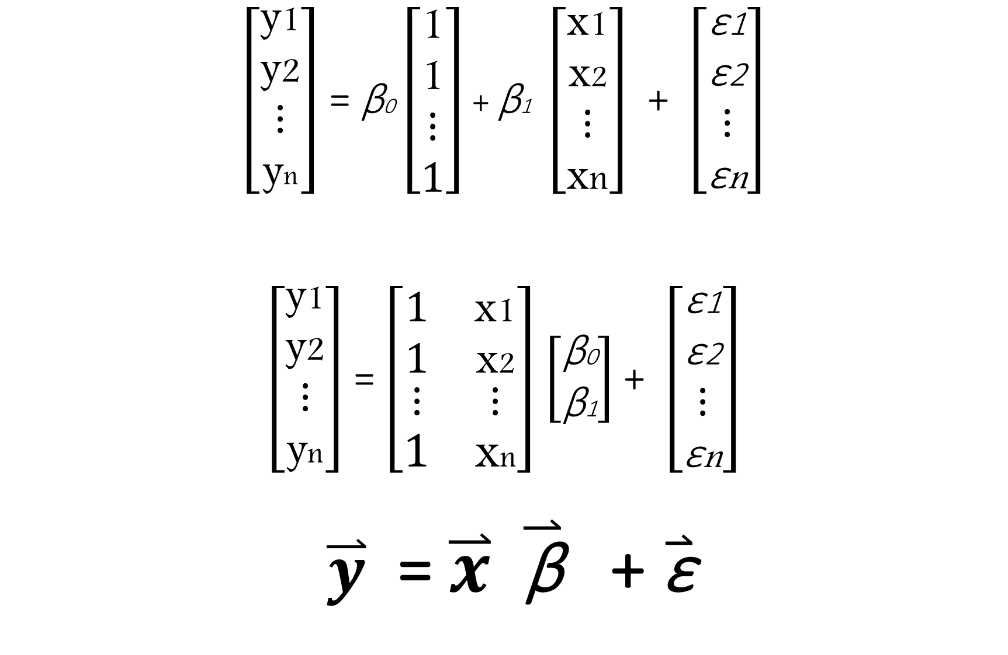
$\left[\begin{aligned}\text{y}\text{1} \\ \text{y}\text{2} \\ ⋮ \\ \text{y}\text{n}\end{aligned}\right]$ = β0 $\left[\begin{aligned}\text{1} \\ \text{1} \\ ⋮ \\ 1\end{aligned}\right]$ + β1 $\left[\begin{aligned}\text{x}\text{1} \\ \text{x}\text{2} \\ ⋮ \\ \text{x}\text{n}\end{aligned}\right]$ + $\left[\begin{aligned}\text{ε}\text{1} \\ \text{ε}\text{2} \\ ⋮ \\ \text{ε}\text{n}\end{aligned}\right]$ $\left[\begin{aligned}\text{y}\text{1} \\ \text{y}\text{2} \\ ⋮ \\ \text{y}\text{n}\end{aligned}\right]$ = $\left[\begin{matrix}1 & \text{x}\text{1} \\ 1 & \text{x}\text{2} \\ \begin{aligned}⋮ \\ 1\end{aligned} & \begin{aligned}⋮ \\ \text{x}\text{n}\end{aligned}\end{matrix}\right]$ $\left[\begin{matrix}\text{β}\text{0} \\ \text{β}\text{1}\end{matrix}\right]$ + $\left[\begin{aligned}\text{ε}\text{1} \\ \text{ε}\text{2} \\ ⋮ \\ \text{ε}\text{n}\end{aligned}\right]$ $\overset{⃑}{y}$ = $\overset{⃑}{x} \overset{⃑}{\text{β}}$​​ + $\overset{⃑}{\text{ε}}$

Slide 16

$\overset{⃑}{y}$ = $\overset{⃑}{x} \overset{⃑}{\text{β}}$ ​+ $\overset{⃑}{\text{ϵ}}$ (the general form of Regression). $\overset{⃑}{y}$ = $\hat{y}$ ​+ $\overset{⃑}{\text{ϵ}}$ $∴\hat{y}$ = $\overset{⃑}{x} \overset{⃑}{\text{β}}$ $\overset{⃑}{\text{ϵ}}$ = $\overset{⃑}{y}$ - $\hat{y}$ = $\overset{⃑}{y}$ - $\overset{⃑}{x} \overset{⃑}{\text{β}}$

Slide 17
Multiple Regression

Slide 18
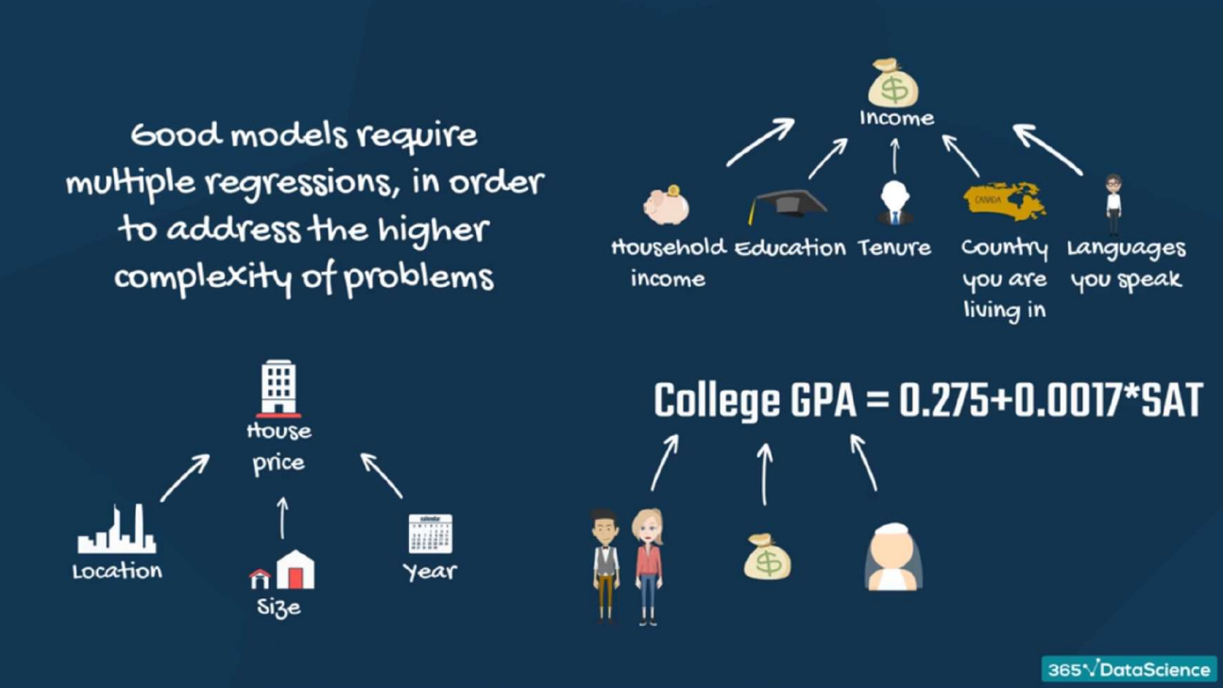

Slide 19
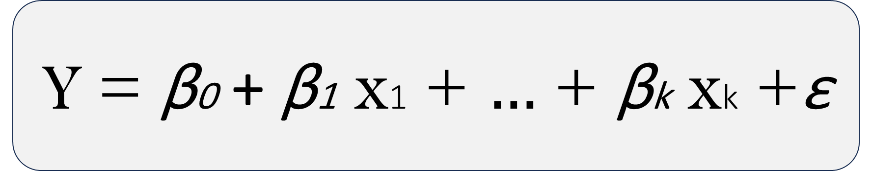
Y = β0 + β1 x1 + $…$ + βk xk +ε
Multiple Regression Model

Slide 20

Do you remember the general form of Regression? $\overset{⃑}{y}$ = $\overset{⃑}{x} \overset{⃑}{\text{β}}$ ​+ $\overset{⃑}{\text{ϵ}}$ We will apply it on multiple regression :

Slide 21
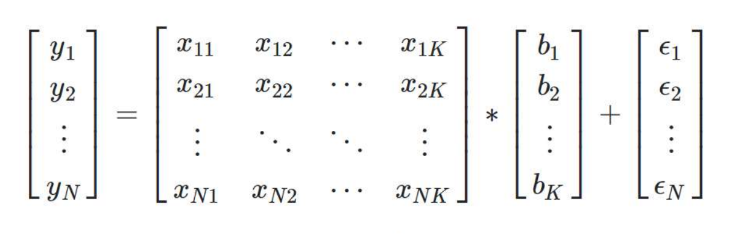

$\overset{⃑}{y}$ = $\overset{⃑}{x} \overset{⃑}{\text{β}}$ ​+ $\overset{⃑}{\text{ϵ}}$

Slide 22
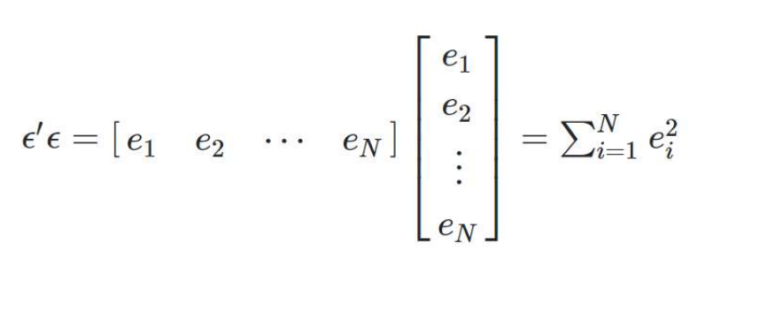
So, we want to minimize the error !
So we want to reduce the error

Slide 23

we know that : $\overset{⃑}{\text{ϵ}}$ = $\overset{⃑}{y}$ - $\overset{⃑}{x} \overset{⃑}{\text{β}}$ $∴ԑ^{T}ԑ$ = ${\text{(}\overset{⃑}{ y}\text{ − }\overset{⃑}{x} \overset{⃑}{\text{β}} \text{)}}^{T}$ ( $\overset{⃑}{y}$ - $\overset{⃑}{x} \overset{⃑}{\text{β}}$ ) $ԑ^{T}ԑ$ = [ $y^{T}$ - ${\text{(}\overset{⃑}{x} \overset{⃑}{\text{β}}\text{ ) }}^{T}$ ] * ( $\overset{⃑}{y}$ - $\overset{⃑}{x} \overset{⃑}{\text{β}}$ ) $ԑ^{T}ԑ$ = [ $y^{T}$ - ${ \text{β}}^{T}$ $x^{T}$ ] * ( $\overset{⃑}{y}$ - $\overset{⃑}{x} \overset{⃑}{\text{β}}$ ) $ԑ^{T}ԑ$ = $y^{T}y$ - $y^{T}x \text{β}$ - ${ \text{β}}^{T}$ $x^{T}y$ + ${ \text{β}}^{T}$ $x^{T}x \text{β}$ $ԑ^{T}ԑ$ = $y^{T}y$ - $2$ ${ \text{β}}^{T}$ $x^{T}y$ + ${ \text{β}}^{T}$ $x^{T}x \text{β}$ (1)

Slide 24

$ԑ^{T}ԑ$ = $y^{T}y$ - $2$ ${ \text{β}}^{T}$ $x^{T}y$ + ${ \text{β}}^{T}$ $x^{T}x \text{β}$ So, the derivative will be : $\frac{∂(ԑ^{T}ԑ)}{∂\text{β}}$ = - 2 $x^{T}y$ + 2 $x^{T}x \text{β}$ = 0 ${∴ x}^{T}x \text{β}$ = $x^{T}y$ $∴$ $\text{β}$ = ${({ x}^{T}x )}^{−1}$ $x^{T}y$ #
(1)

Slide 25
Thank you!

